Slide 1
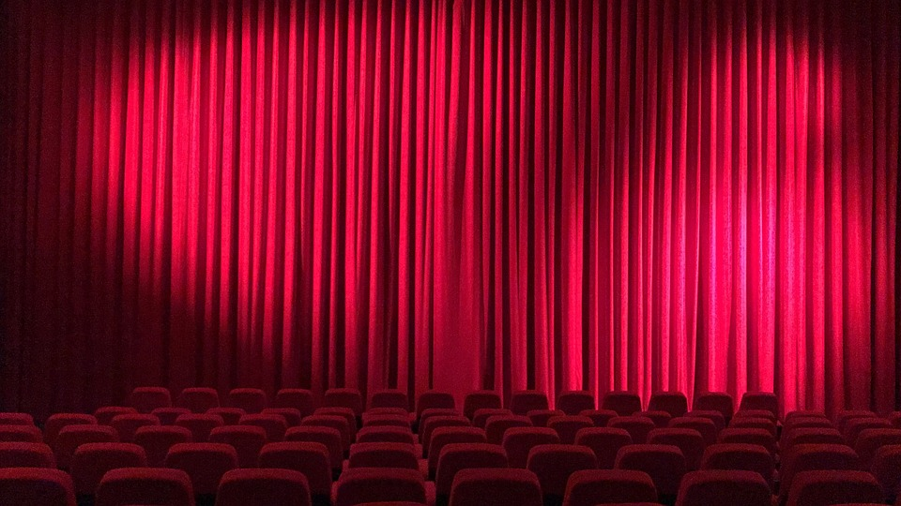
PROJECT PRESENTATION
MOVIE TICKET BOOKING SYSTEM (WITH REVENUE TRACKING)
NAME: ROHIT SINGH RAJAWAT
SAP ID: 590027753
BATCH: 60

Slide 2
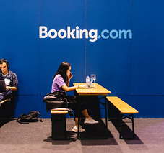

INTRODUCTION
Purpose: Automate theater seat booking and revenue management
Input:
Customer Name and Phone Number
Movie Selection
Seat Selection (Row and Column)
Output:
Booking Confirmation with Price
Seat Availability Matrix
Revenue Reports
Booking Records (saved to file)

Slide 3


PROBLEM DEFINITION
MANUAL BOOKING IS TIME-CONSUMING
Tracking 100 seats per movie manually is difficult
High chance of double-booking errors
HIGH CHANCE OF HUMAN ERROR
Mistakes in calculating revenue
Confusion in seat availability
CHALLENGES IN PRESENTING SEAT STATUS CLEARLY
Difficult to visualize which seats are available
DIFFICULT IN MANAGING MULTIPLE MOVIES
Need to track 4 different movies simultaneously
Complex revenue calculation for different price zones
NEED FOR STANDARDIZED PRICING SYSTEM
Dynamic pricing based on seat location (front/middle/back)

Slide 4
WHY THIS PROJECT MATTERS ?
Motivation & Scope
Why It's Important:
Eliminates Human Error - Automated validation prevents mistakes
Saves Time - Reduces booking time from 5 minutes to 30 seconds
Improves Customer Experience - Clear seat visualization & instant confirmation
Financial Transparency - Real-time revenue tracking per movie
Project Scope:
✓ Manage 4 concurrent movies
✓ 100 seats per movie (10×10 matrix)
✓ Dynamic pricing based on seat location
✓ Customer data management with file storage
✓ Revenue tracking & reporting

Slide 5
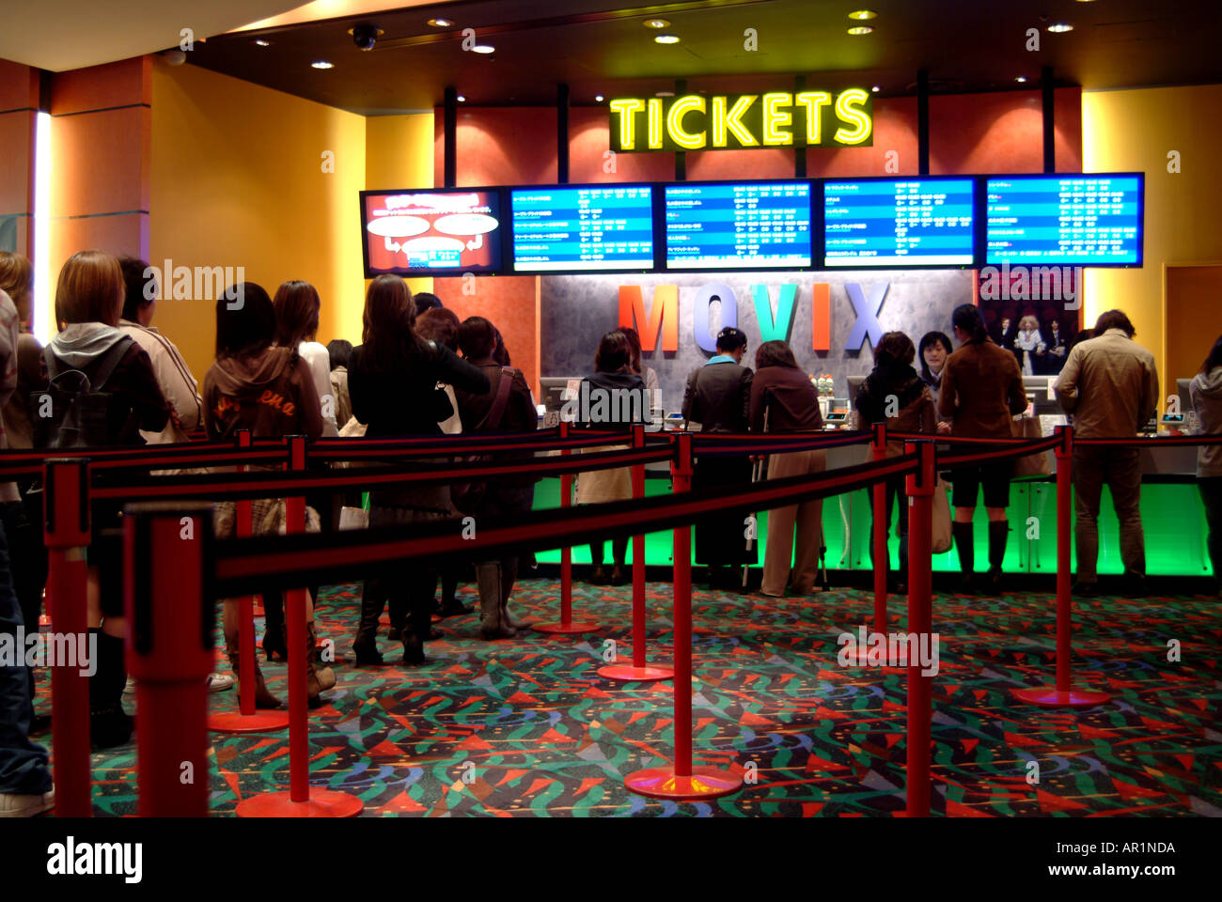
SYSTEM DESIGN
Uses structures for:
Show information (movie name, seats, revenue)
Booking details (customer info, seat, price)
Dynamic pricing mechanism:
Front rows (1-3): ₹150
Middle rows (4-7): ₹200
Back rows (8-10): ₹250
Key algorithms:
Seat availability checking
Revenue calculation and tracking
File I/O for persistent storage
Data organization:
2D array (10×10) for seat matrix
Global array for 4 movies

Slide 6
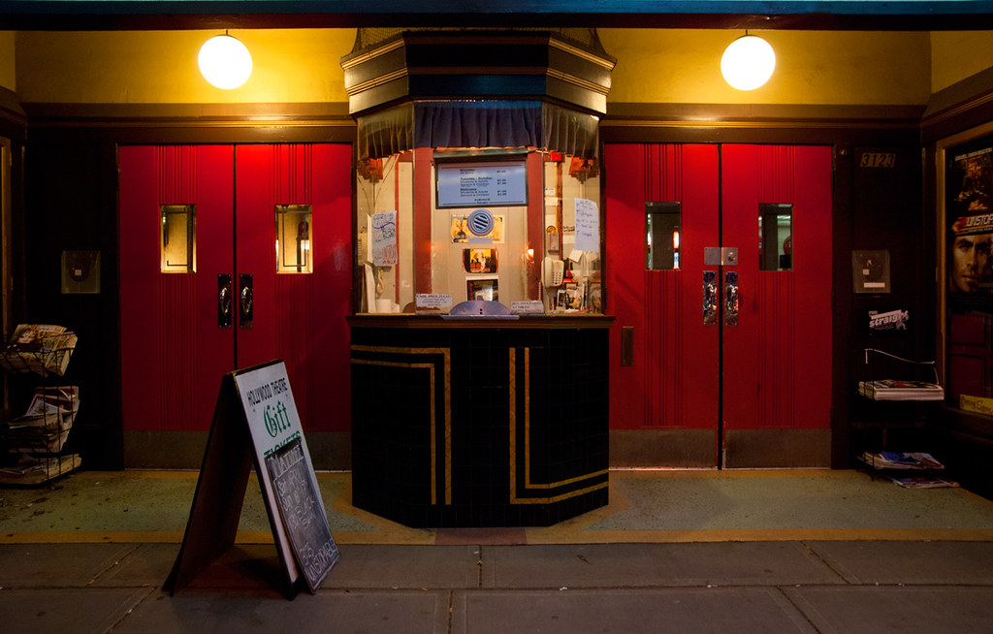
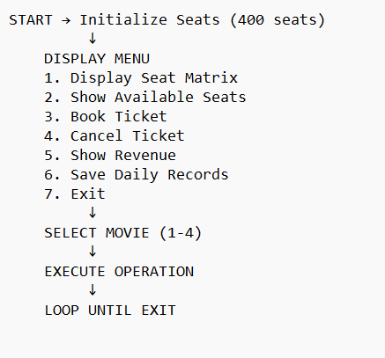
SYSTEM WORKFLOW
Main program flow

Slide 7
KEY FEATURES
What Makes This System Effective ?
Technical Features:
Real-time Seat Updates - Instant availability check
Input Validation - Prevents invalid seat selection
Double Booking Prevention - Checks before confirming
Automatic Price Calculation - Based on row position
Persistent Storage - File-based booking history
Revenue Tracking - Per-movie financial reports
User Experience:
👤 Customer information capture
📍 Clear seat visualization
💳 Mock payment link generation
📧 Booking confirmation display

Slide 8
NOVELTY & CONTRIBUTIONS
What's Unique About This Project ?
1. Dynamic Tiered Pricing System
Not just fixed pricing
Front/Middle/Back zones with different rates
Encourages balanced seat distribution
2. Multi-Movie Management
Single system handles 4 movies simultaneously
Independent seat matrices and revenue tracking
Scalable design
3. Dual View System
Matrix view for visual seat selection
List view for price-based selection
4. File-Based Audit Trail
Every booking permanently recorded
Separate daily records for management
Easy dispute resolution

Slide 9
FUTURE ENHANCEMENTS
Short-term (Easy to Implement):
🕐 Add show timings (morning/evening/night)
📅 Date-wise booking calendar
👥 Multiple seat booking in one transaction
🎨 Color-coded seat display
Medium-term:
🔐 Admin authentication system
📊 Analytics dashboard (most popular movies)
💾 Replace file storage with SQLite database
📱 Generate QR code tickets
Long-term (Advanced):
🌐 Web interface using CGI
💳 Real payment gateway integration
📧 Email/SMS confirmations
🎯 AI-based seat recommendations
📈 Dynamic pricing based on demand

Slide 10
CHALLENGES FACED
Challenge 1: Input Buffer Issues
Problem: scanf() leaving newline characters
Solution: Used %[^\n] format specifier and buffer clearing
Challenge 2: 0-based vs 1-based Indexing
Problem: User sees Row 1-10, array uses 0-9
Solution: Systematic conversion (row--, col--) before processing
Challenge 3: File Append Mode
Problem: Previous data getting overwritten
Solution: Used "a" (append) mode instead of "w" (write)
Challenge 4: Data Persistence
Problem: Bookings lost when program exits
Solution: Immediate file write after each booking

Slide 11
REFERENCES
Resources Used
Books:
Kernighan & Ritchie - The C Programming Language (2nd Edition)
Yashavant Kanetkar - Let Us C (17th Edition)
Online Resources:
GeeksforGeeks - C Programming Tutorials
https://www.geeksforgeeks.org/c-programming-language/
Programiz - C Structures and File Handling
https://www.programiz.com/c-programming
Tutorials Point - C Arrays and Pointers
https://www.tutorialspoint.com/cprogramming/
Course Materials:
Tools:
VS Code - Code editor
GCC Compiler - Code compilation

Slide 12
Thank you

